Slide 1
Sterling Household Products
HBSP case # 913-556
Pointers & Questions

Slide 2
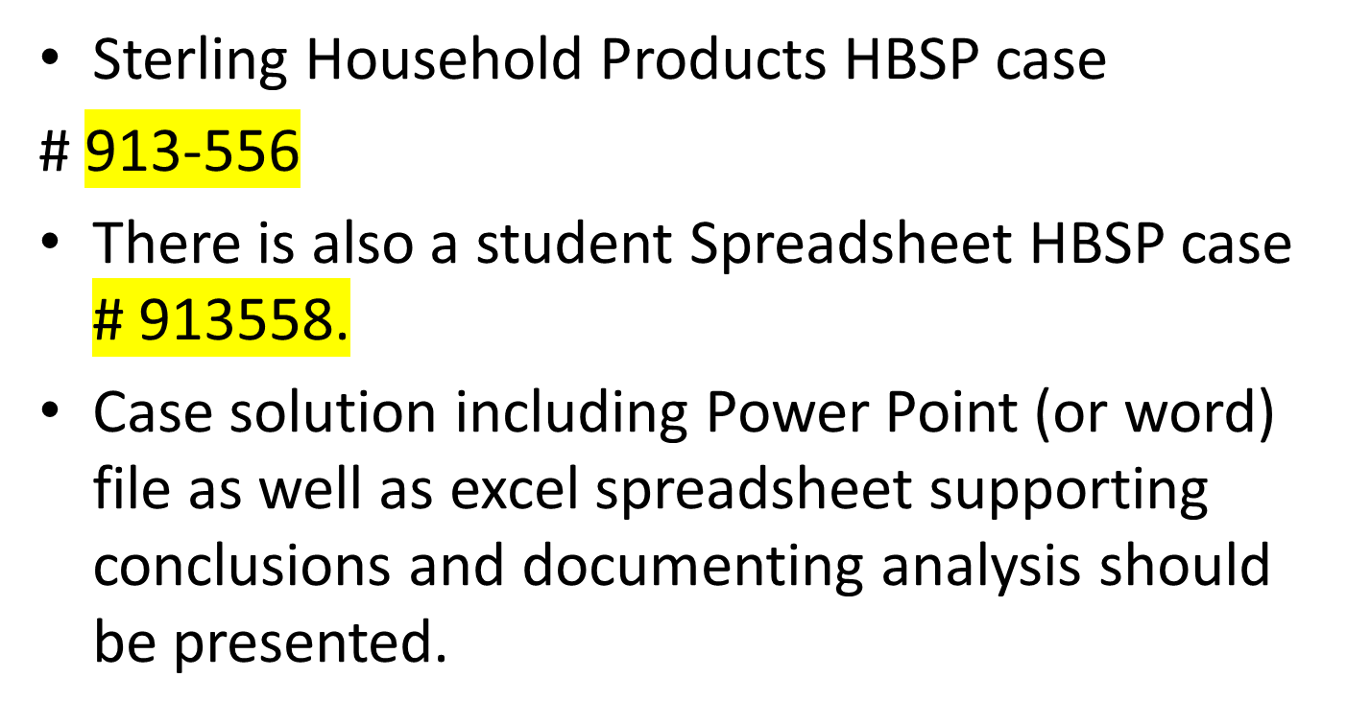
Presentation Case study

Slide 3
Pointers
A comprehensive case – you can use cumulative knowledge Including:
M & A deal;
Assumptions / Projections / Pro Formas using % of Sales method etc.
NPV
Risk Assessment

Slide 4
Pointers
Sterling is interested in acquiring Montagne Medical Instruments’ germicidal, sanitation & antiseptic products unit
And Montagne is open to this; hence a “friendly” deal

Slide 5
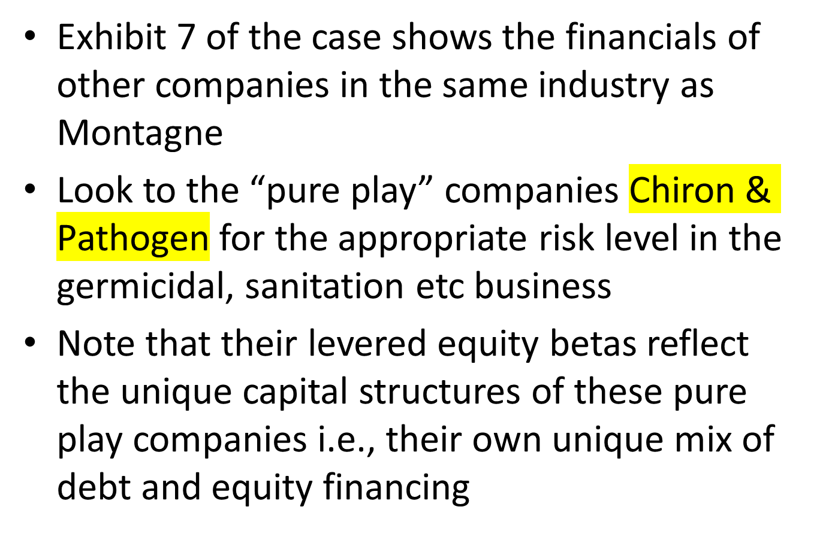
Pointers

Slide 6
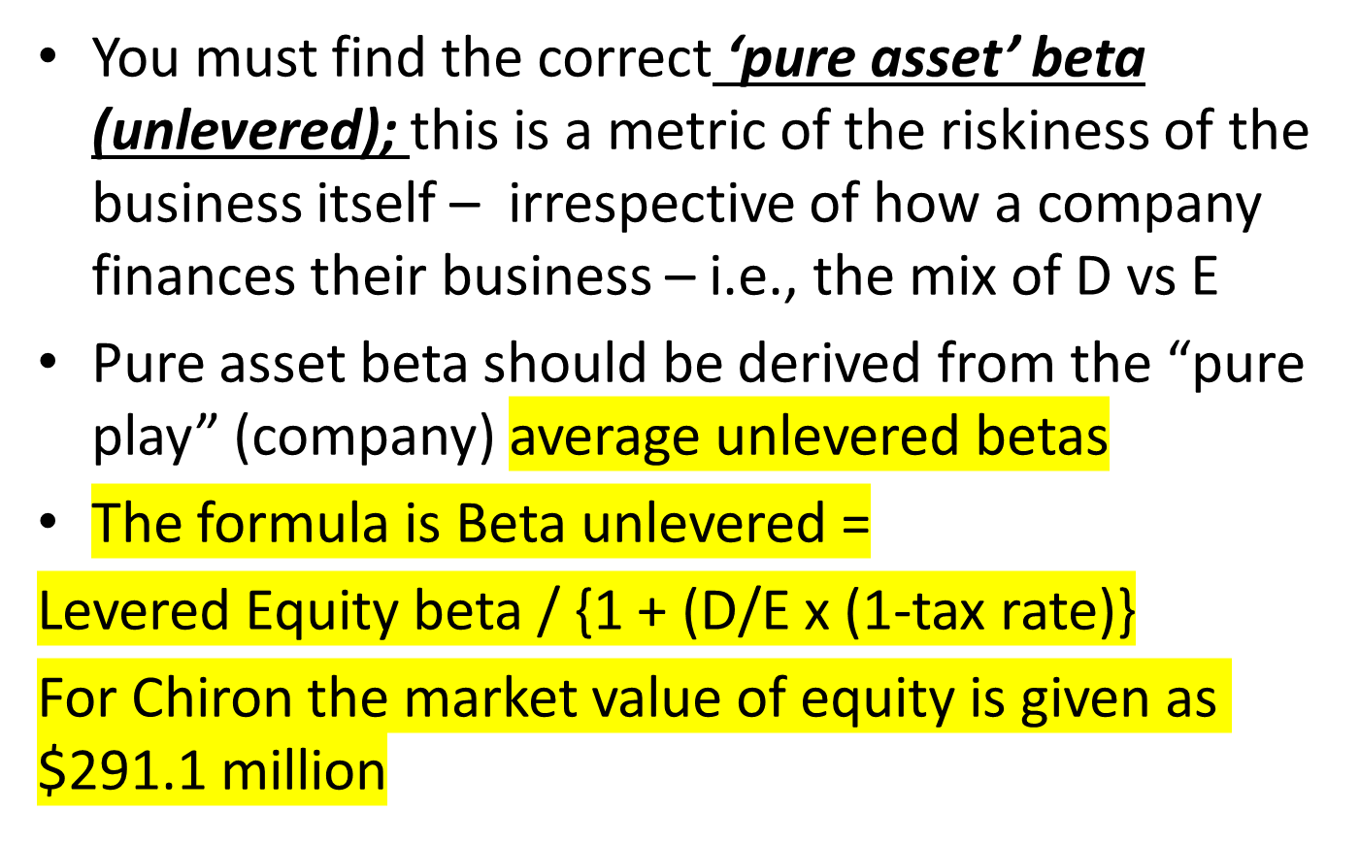
Pointers

Slide 7
Pointers
And for the Chiron the value of debt is 20% x $164 million = $32.8 million
Hence $32.8 / $291.1 = .11268 and
Multiplied by .65 = .07324
Add 1
and unlever by taking .85 / 1.07324 = .79

Slide 8
Pointers
This makes sense in that without debt in the capital structure, the firm is less risky. I.e., this “unlevered” beta is a reflection of the riskiness of the business itself; irrespective of how the company chooses to finance the business
You should do the same for Pathogen and calculate the average unlevered beta of the “pure plays”

Slide 9
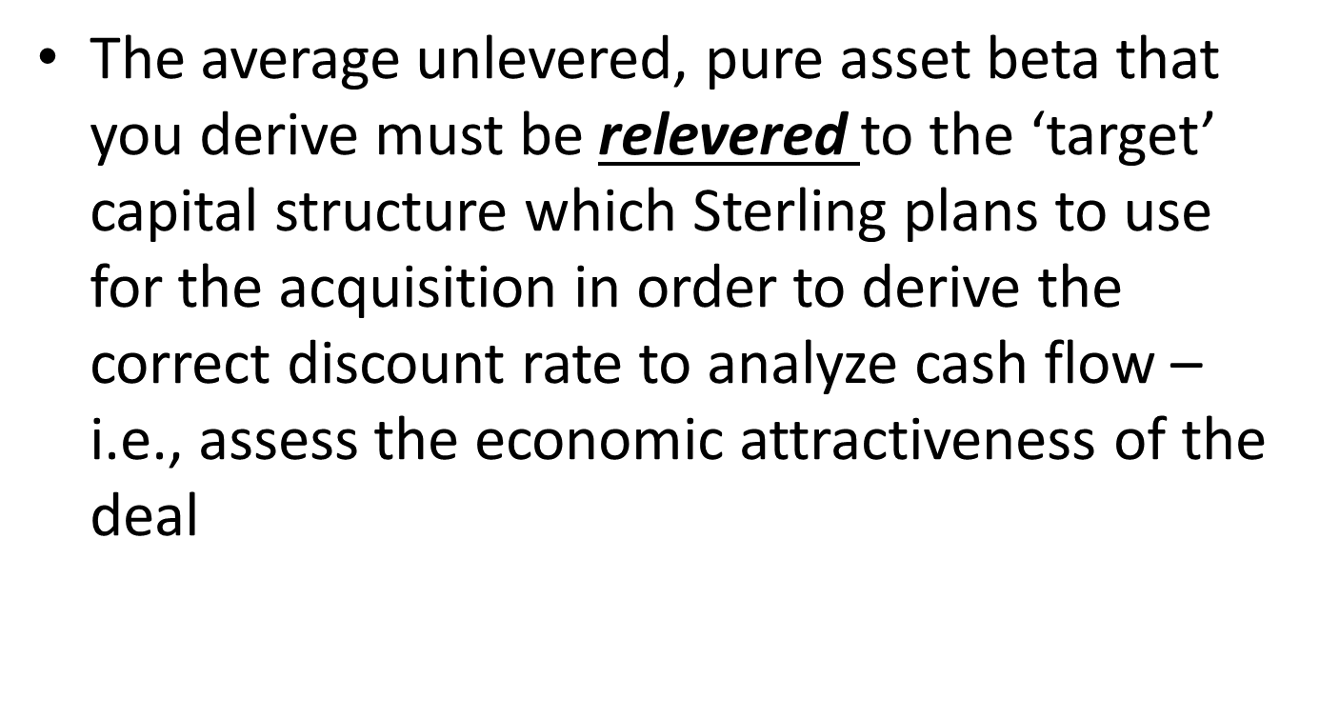
Pointers

Slide 10
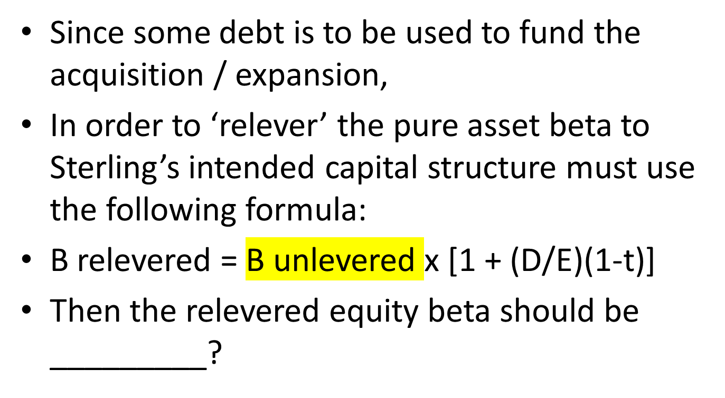
Pointers

Slide 11
Pointers
Must calculate cost of equity using beta relevered to target capital structure using the CAPM
That is Re = Rf + (Beta x EMRP)
Hence the cost of equity will be ________ as debt is introduced – why?

Slide 12
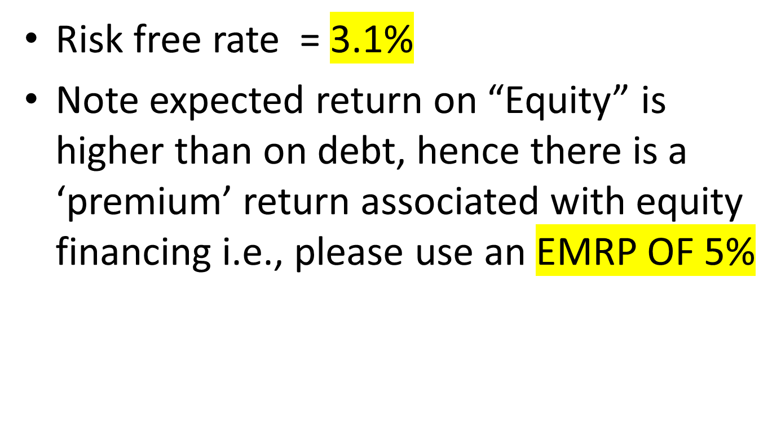
Pointers

Slide 13
Pointers
Once have cost of equity, as levered for the prospective target capital structure then can calculate the WACC that should be used for the base case to see if the cash flow projections indicate that value is expected to be created

Slide 14
Pointers
Project cash flows through 2022
Remember to do this on an “after-tax” basis including the benefit from depreciation tax shield for investment in PPE (which in turn must be updated) for any new investment
Also be sure to incorporate any change in net working capital
Do this for acquisition; then separately same calculation for follow-up investment in expansion

Slide 15
Pointers
Don’t forget Terminal Value which is
discussed in the case – note terminal value calculated as follows:
Final year’s FCF x (1+G) / (WACC – G) and include the result in the final year’s total cash flow – to be discounted back to today
Make sure to support answers to questions with analysis but - Be concise

Slide 16
Pointers
Please make sure to include word (or ppoint) as well as excel files and PROVIDE ME WITH A HARD COPY BEFORE CLASS

Slide 17
Questions
Questions to be answered for Sterling Household Products Case Study:
1 . Briefly describe the business risk is associated with Sterling’s proposed acquisition of the germicidal, sanitation and antiseptic products unit of Montagne Medical? What is the cost of equity capital appropriate for evaluating the free cash flow associated with this investment? What is the correct capital structure and weighted average cost of capital for discounting the investment’s free cash flow?

Slide 18
Questions
2. What are the amounts and timing of the acquisition investment’s free cash flow from 2013 through 2022? What is the terminal value of the final 10 years of the acquisition, as of 2022? What is the NPV to Sterling of this base investment? What are the amounts and timing of the possible follow-up expansion investment opportunity’s free cash flow from 2013 through 2022? What is the terminal value of the final 10 years of the follow-up acquisition, as of 2022? What is the NPV of this follow-up investment and the combined base expansion investments?

Slide 19
Questions
3. Is the acquisition of Montagne Medical’s germicidal, sanitation and antiseptic products unit value-additive to Sterling?
4. What are the strategic issues associated with the proposed acquisition? What trends or uncertainties do you see which could make the acquisition more or less attractive on both a financial and a strategic basis?

